Slide 1

Climber
A video game using hand-tracking and haptic feedback

Slide 2
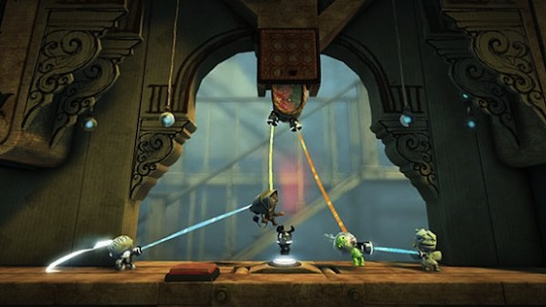
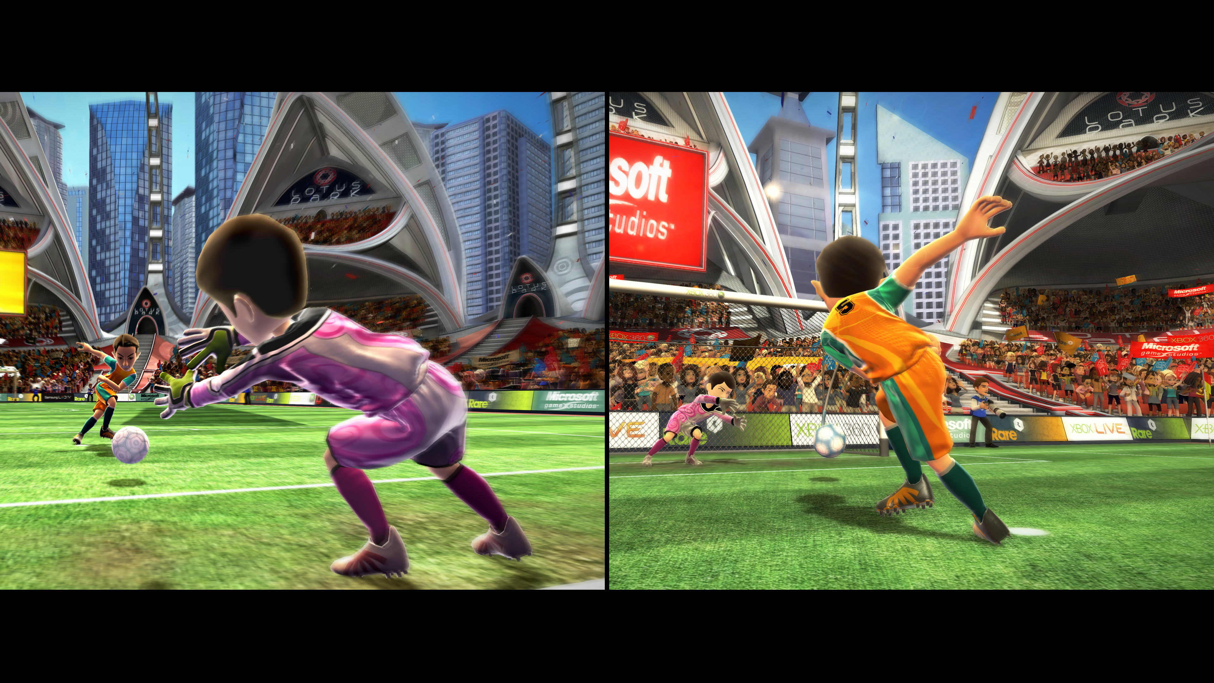
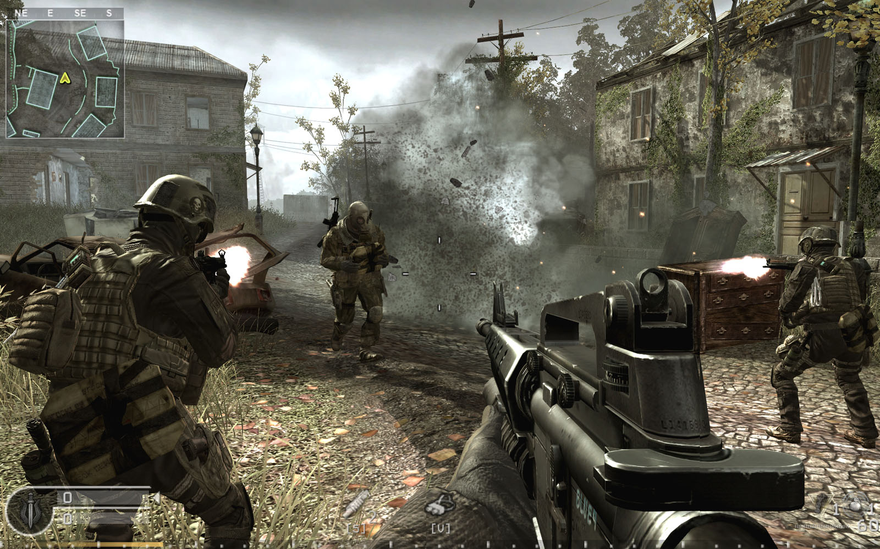
We Play Games for the Experience

Slide 3
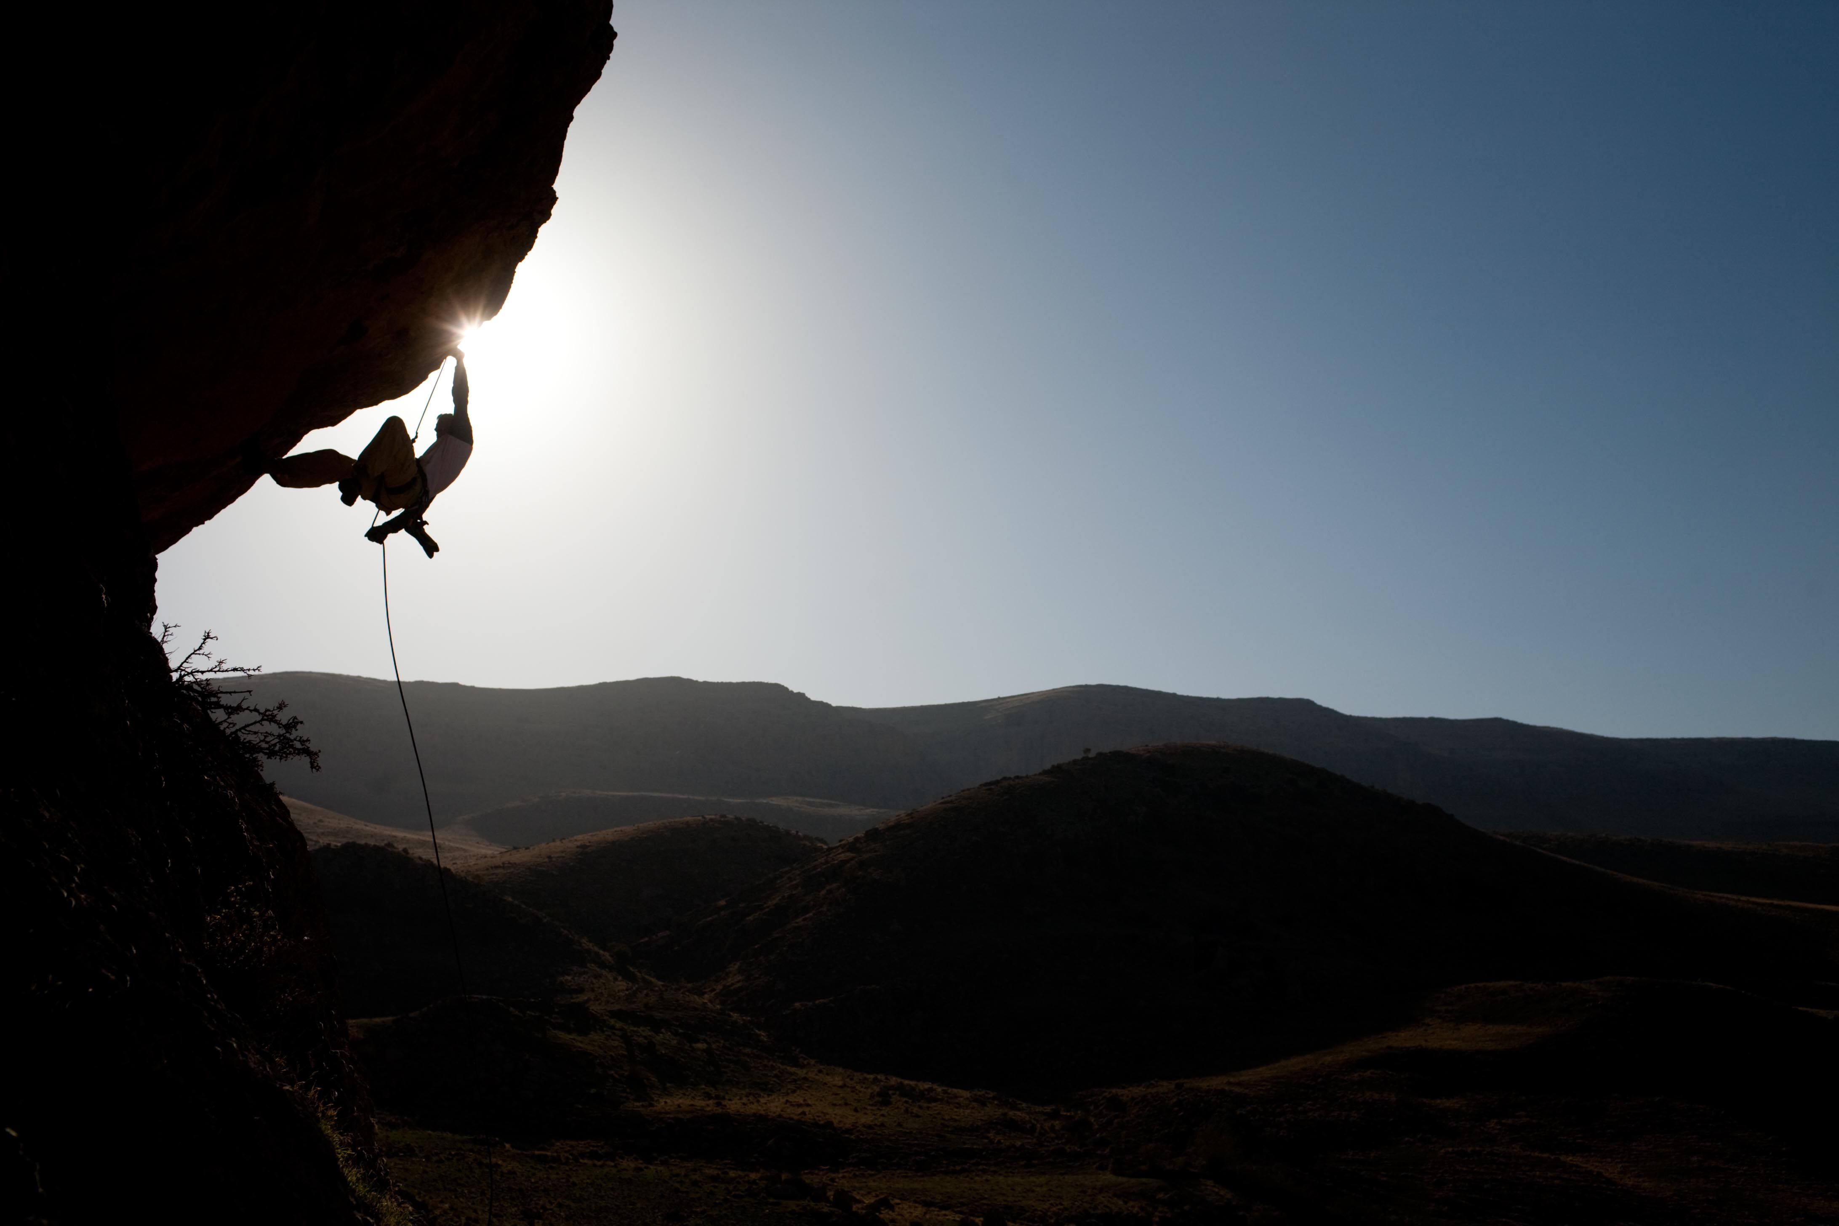
Climbing is Active

Slide 4
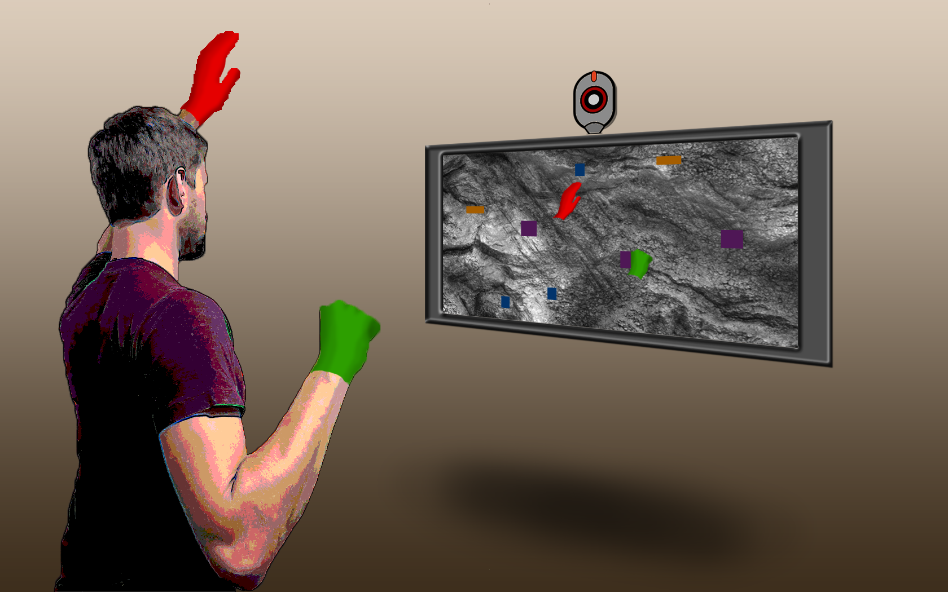
Virtual Climbing: A Better Experience

Slide 5
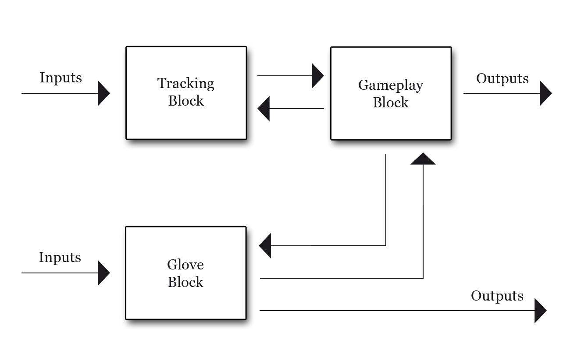
Three-Block Implementation

Slide 6
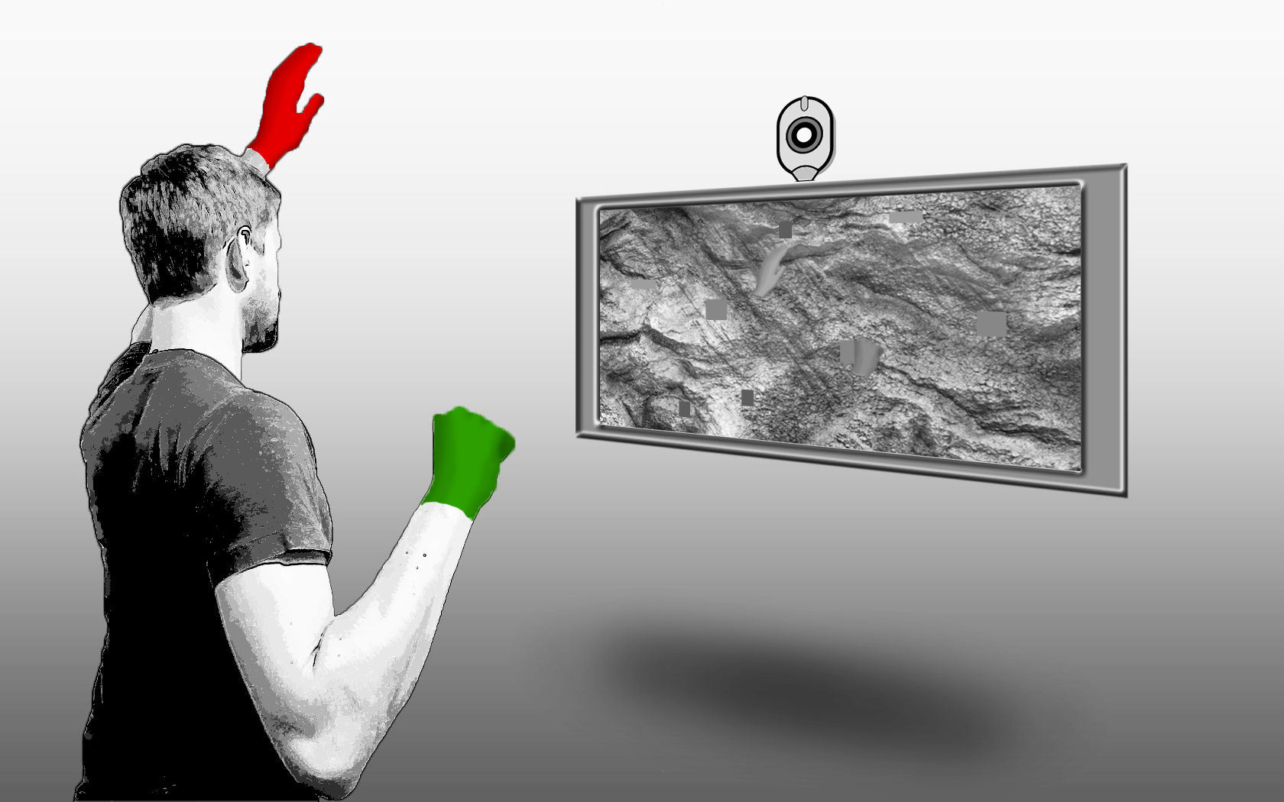
Input and Output Glove

Slide 7
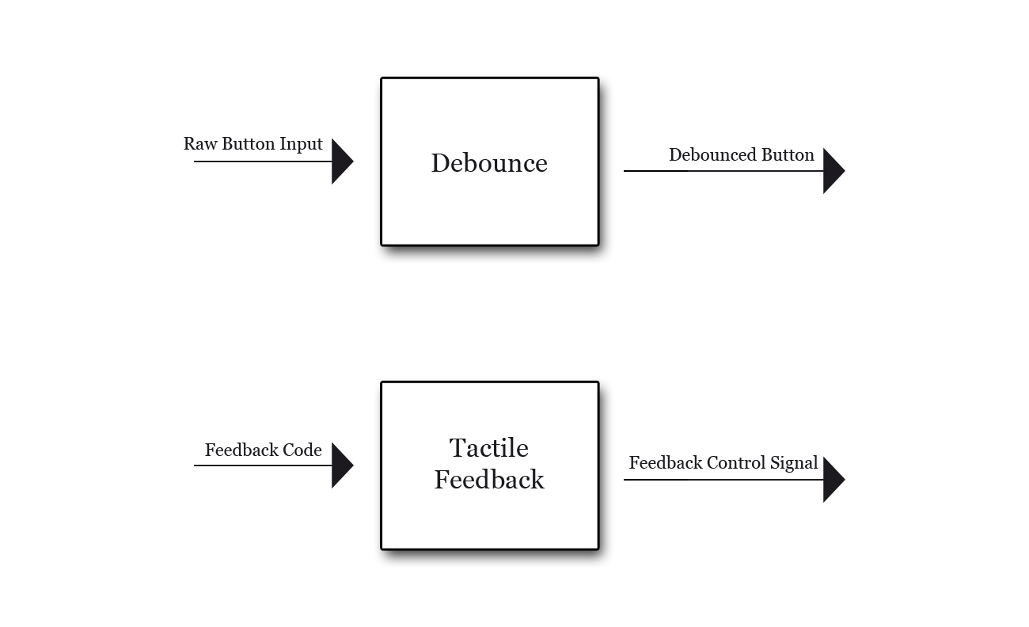
Simply Input-Output Control

Slide 8
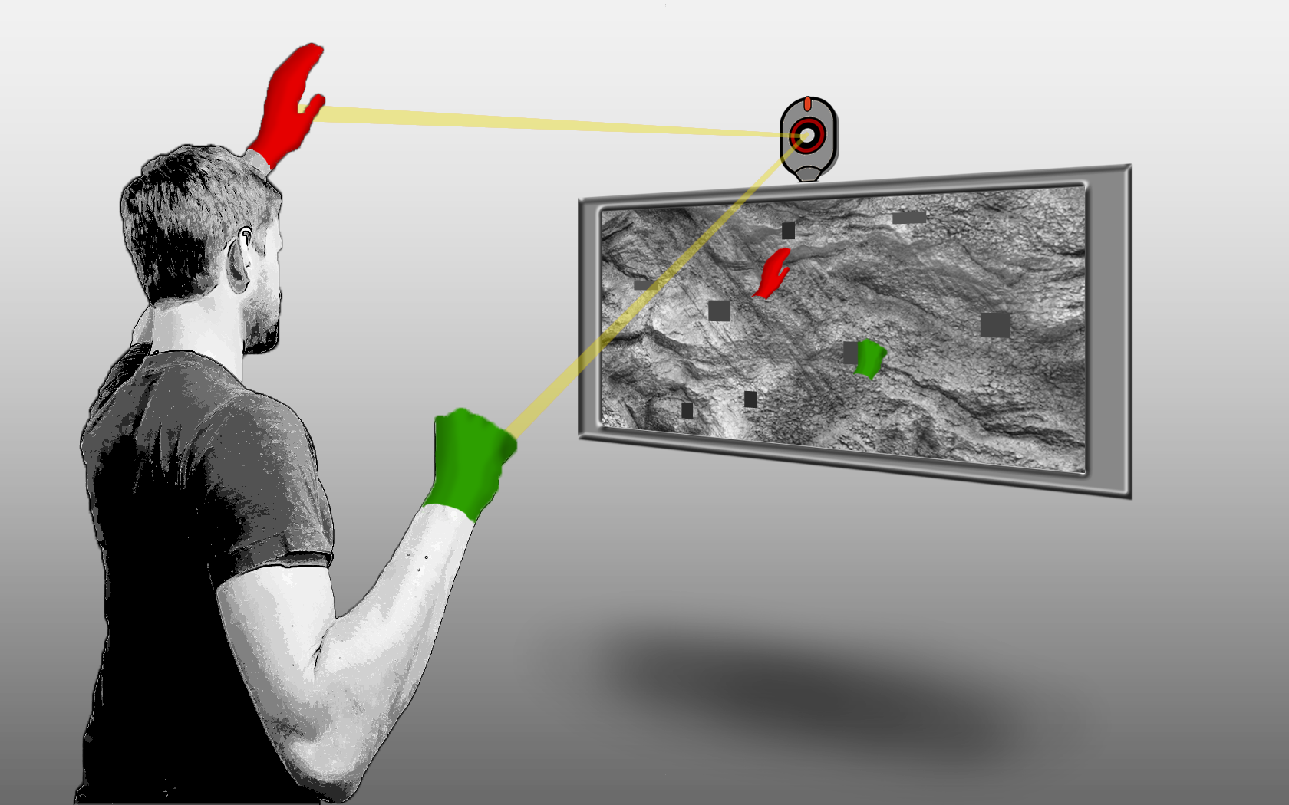
Mapping Movement Through Color Tracking

Slide 9
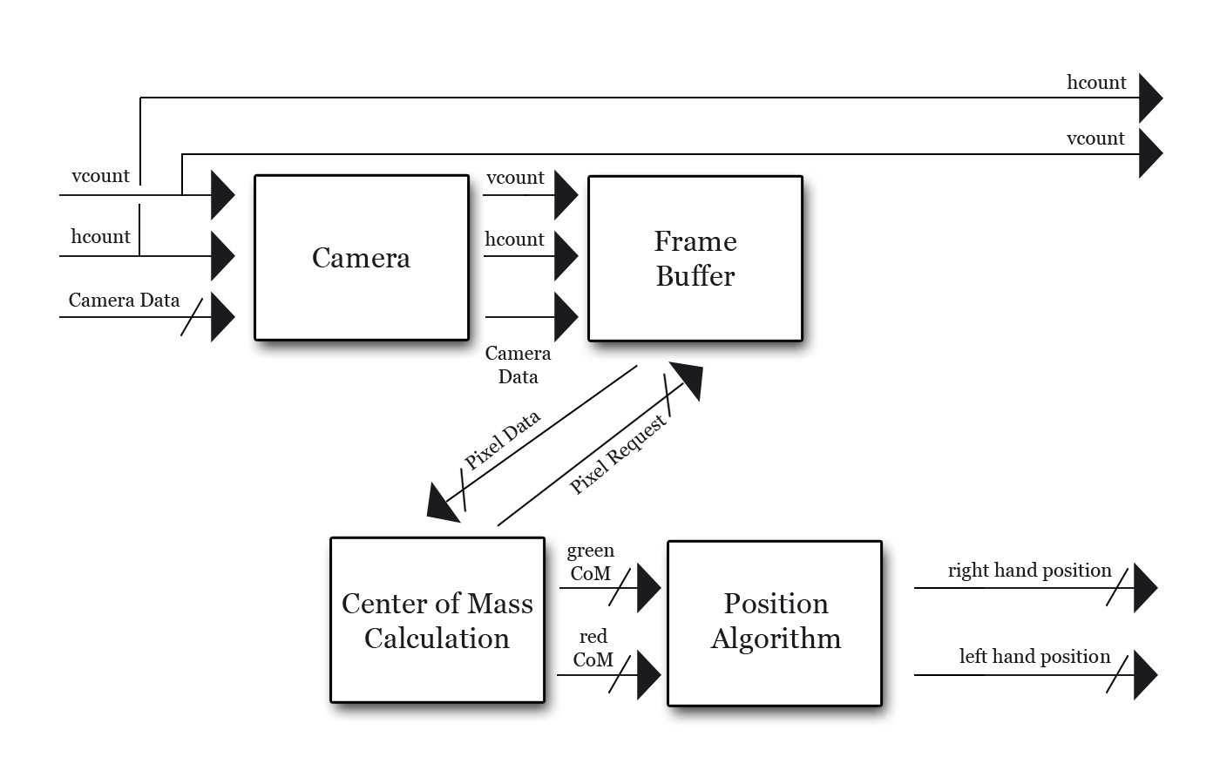
Accurate Camera-Based System

Slide 10
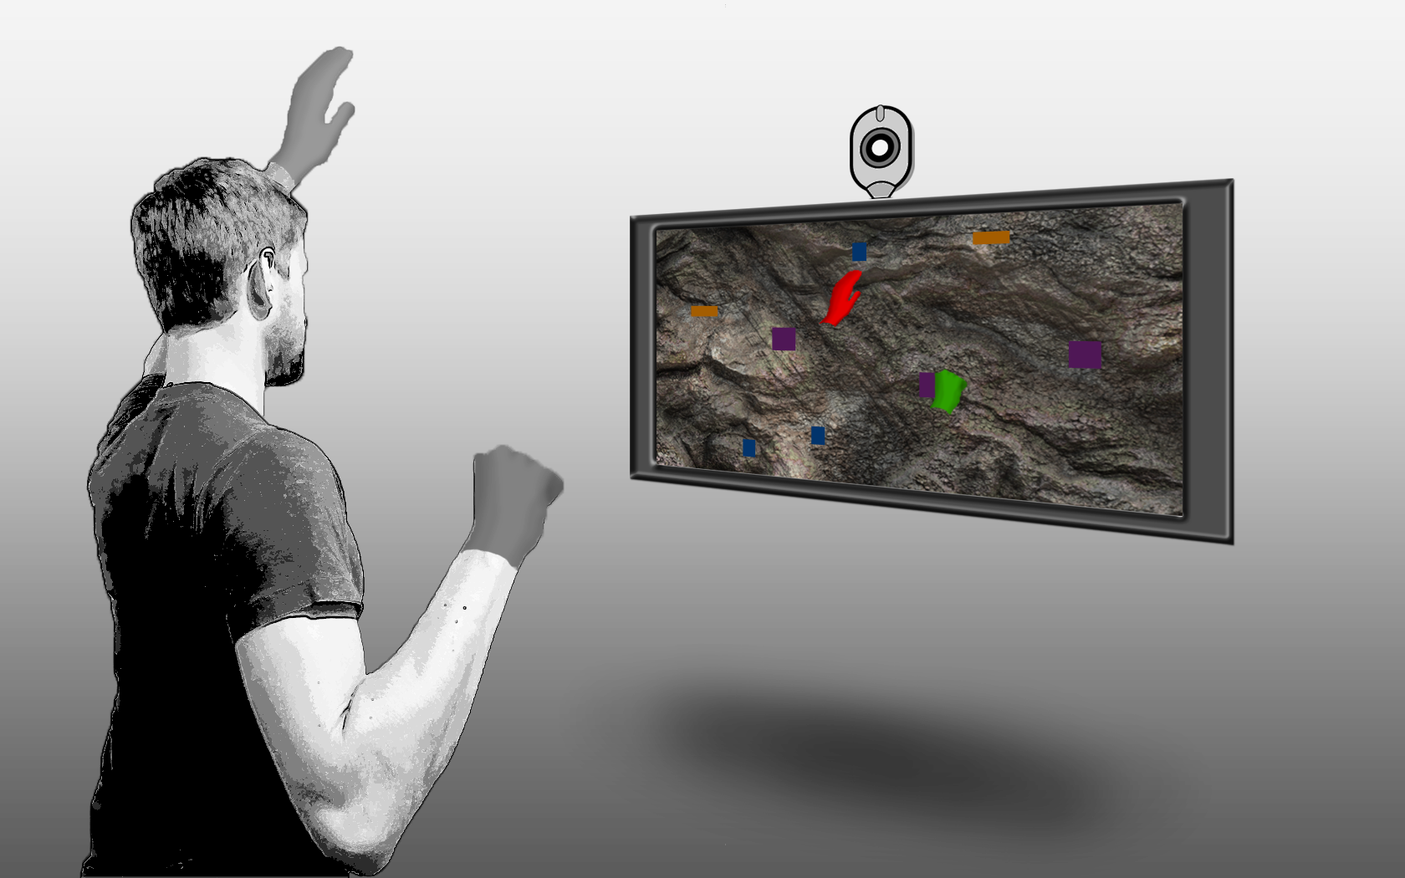
Gameplay Module

Slide 11
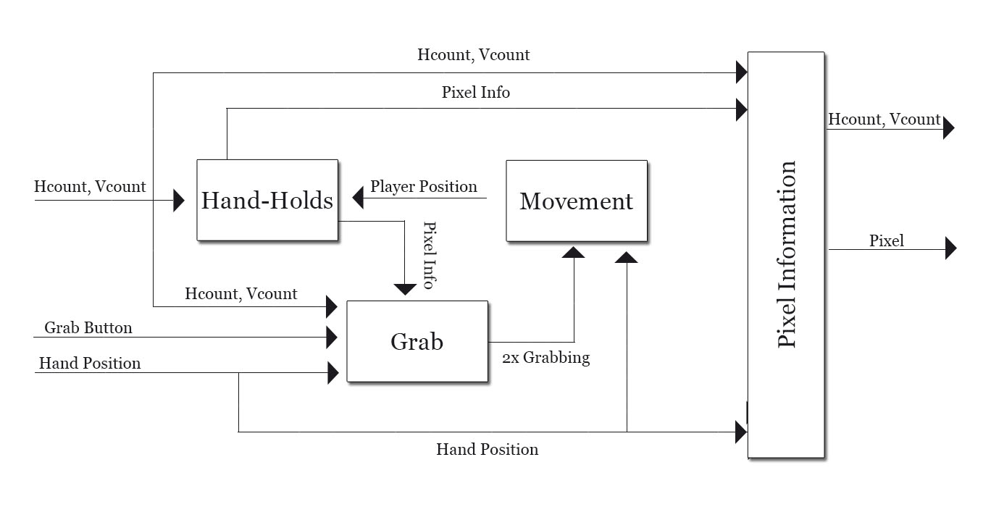
Physics Simulation and Video Output

Slide 12
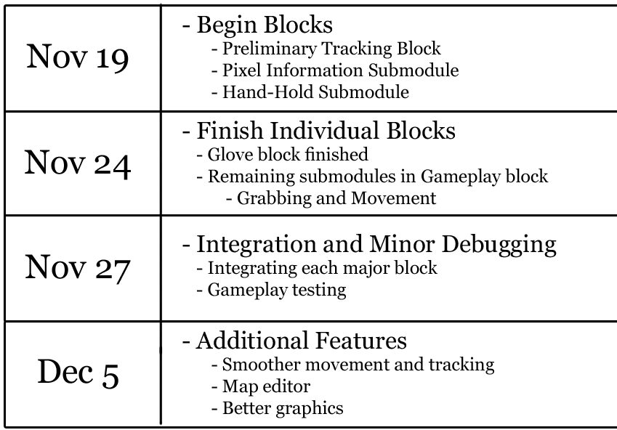
Timeline

Slide 14
Thank You

Slide 15
Image Sources:
http://www.theskichannel.com/news/20091119/your-chance-to-design-the-tom-wallisch-pro-model-kombi-glove-for-next-year/ http://qubegame.blogspot.com/2009/12/glove-design.html http://seamlesstextures.deviantart.com/ http://www.clker.com/clipart-webcam.html http://www.colonyofgamers.com/cogforums/showthread.php?t=18026 http://sebmeyer.com/rock-climbing-in-iraqi-kurdistan http://www.littlebigplanet.com/games/littlebigplanet-2 http://applications-station.blogspot.com/2013/08/free-download-call-of-duty-4-highly.html

